Slide 1
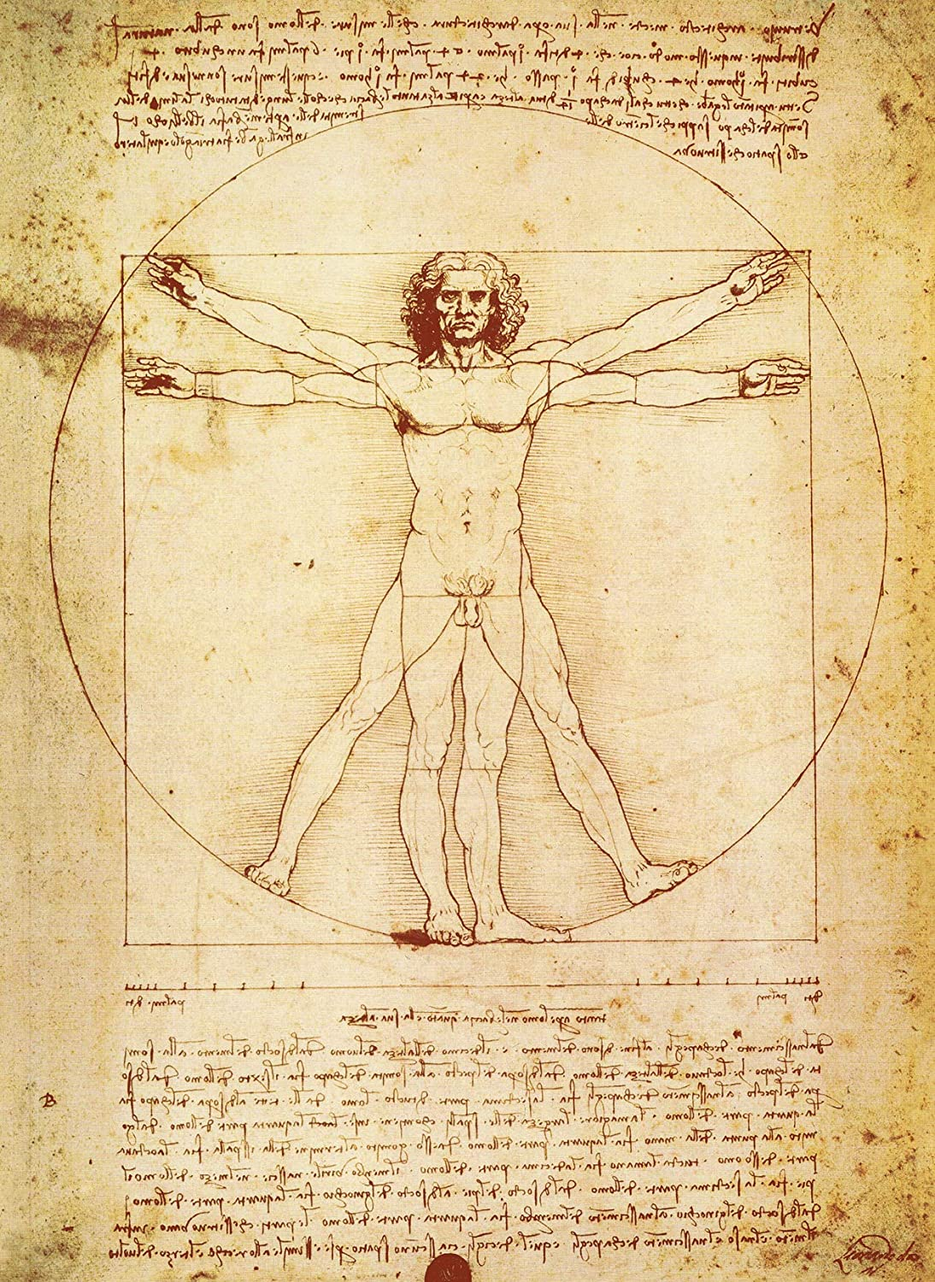
Extracting Body Function from Clinical Text
August 26, 2021
Presentation to SSA
Notes:
Greetings: This presentation is on Extracting Body Function From Clinical Text
I am Guy Divita
I would like to Acknowledge my co-authors Jessica Lo,
Chunxiao Zhou,
Kathleen Coale and Beth Rasch

Slide 2



Body Function Explained
Body Functions Related to Work
Info on pathologies within underlying body systems or structures
Strength
Range of Motion
Reflex
Qualifiers are categorized into
-1 (some kind of deficit)
0 (not able to classify)
+1 ( at normal or above level of functioning)
Fully Formed Body Function Mention
Body Function Type
Body Location (optional)
Qualifier
Strength in right lower extremity 5/5
Notes:
We are interested in finding Body Function mentions in clinical text.
*1 Body Functions are pieces of evidence around
pathologies within underlying body systems and structures.
2* Those that we are initially targeting (as they relate to work) are Strength, rom, reflexes.
3* Our benefactors are the Social Security Administration.
We’ve been tasked with helping them in
how they do
Disability adjudication.
Body Function –
We want to highlight body function mentions.
A fully formed mention includes
6* some kind or type – strength, rom, reflex,
7* (Optionally) some indication of where
– body anatomy or location (including laterality),
8* and a Qualifier of that body function observation.
9* Further, it would be helpful to classify the qualifier as part of finding that mention.

Slide 3
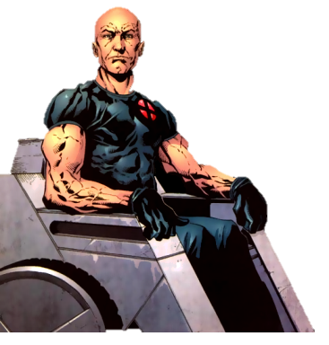
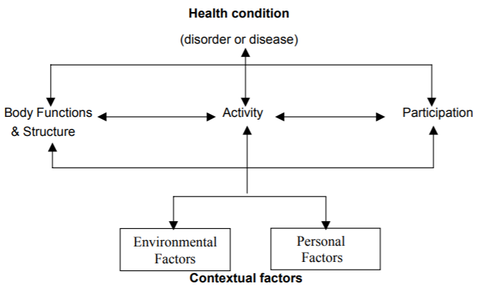
Perspective: International Classification of Function
Body Function, AS it relates to an individual’s Activity and Participation
Professor X
Notes:
Our organization adheres to the perspective/model/world view described by
the WHO’s International Classification of Function and Disability
– that is there is utility in noting Body Function
AS it relates to an individual’s activity and participation.
-----------------------
Skip for AI4Function
+----
|SSA’s uses for Body Function as a diagnosis/finding
|
|Body Function mentions are inadequate to determine whether |someone can or cannot work
+----- Our benefactor, the Social Security Administration,
uses Body Function more as diagnosis or Finding
that maps to disability determinations of various sorts.
The perspective we have is that body function mentions in clinical text are
inadequate, inefficient, and possibly fallacious as evidence
as it relates to whether an individual can or cannot work.
Take Professor X. No strength or ROM in lower extremities.
This would be grounds for highlighting this to a disability adjudicator,
and yet, he has continued to work for Marvel for decades.

Slide 4
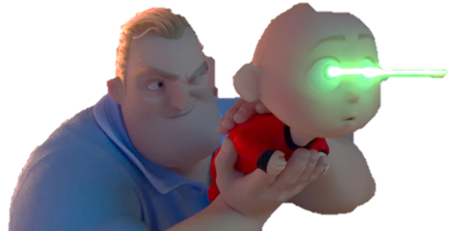

Challenges
Body Function mentions are embedded in highly formatted structures
Body Function mentions confound existing NLP segmentation and document decomposition techniques
Sectionizing
Sentence
Phrase
{ }
Notes:
One of challenges is that
Body Function mentions are nestled or embedded in
clinical text
in formats and descriptions
that are not readable by mere mortals.
It takes super human intelligence and training to understand such mentions.
We are interested in ferreting out the mentions that are authored by clinicians
– the PT/OT community, in particular.
This is a truly distinct sub-language within the
realm of medicine.
Identifying Body Function Mentions are more wooly and nebulous than
labs, medications, gene reports, ct scans, path and radiology records.
1* Proper identification and interpretation of Body Function mentions requires
laser-like accuracy
bounding or SCOPING the context they are within.
2* What section is the mention in,
what sentence,
what phrase,
what list element.
The off-the-shelf sentence, section, phrase tokenizers do a poor job currently within clinical documentation.
However, this is not going to be a story of how to improve document segmentation. Not yet.
My hope with this presentation is that it tells a story about
what information is needed to find Body Function Mentions.
---------------
Our real motivation is to build better “document decomposition” tools
to do a better job at not making mistakes
at finding such mentions.
This paper is not about building better document decomposition tools.
This paper is about benchmarking a tool BEFORE we build a better set of tools.

Slide 5


Description of the Corpus
500 NIH Clinical Center Rehab Notes
OT, PT, Physiatry, History and Physical Exams
Training/Testing stratified by document type and annotation types
Distribution of Manual Annotations in NIH Records
Annotation Type | Training | Testing
BF Mention | 1014 | 403
Strength | 917 | 417
ROM | 482 | 221
Reflex | 32 | 8
Body Location | 1001 | 361
Qualifiers | 1014 | 660
Training/Testing are similar populations
Notes:
As to the task of finding Body Function mentions in clinical text. You need data.
Because there was a time lag between initiating the task and receiving SSA data from our benefactors,
we were fortunate to be able to start with data
that came from NIH Clinical Center Rehabilitation Department Notes.
1* We receive the notes from a sister NIH organization: Biomedical Translational Research Information System.
This paper is about what we learned from the NIH notes, not SSA notes.
We had an annotator annotate, 500 notes.
We used 350 for training and 150 testing notes.
The annotation counts are listed here.
2* I’m making a point here to express that our training data and testing data were segmented in such a way
that those two
pretty much represent the same statistical population.

Slide 6



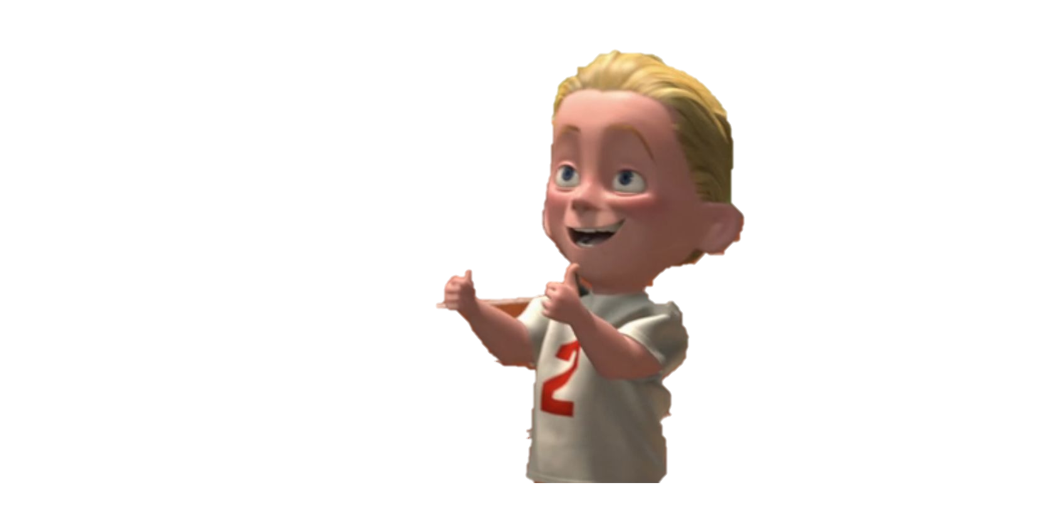
Annotators and Inter-Rater Reliability
These annotations are well vetted, quality
Annotator was supervised by Experienced PT/OT Clinicians
Second annotator trained on NIH Records, IRR with First Annotator = .70
Take Home Message: This task is not too hard
IRR on NIH Records
IIR on SSA Records
NIH Records
Round | Macro F1 | BF F1
1 | .52 | .38
2 | .57 | .52
3 | .77 | .71
SSA Records (274 pages to date)
Notes:
Our first annotator,
though not a clinician (yet), was supervised by experienced PT people. The annotations are literally golden.
That first annotator annotated the 500 BTRIS/NIH records before 1* our second annotator got spun up.
2* There was an interannotator agreement task done to insure our second annotator and the first annotator were consistent.
Just as that finished, our pioneering Body Function superhero annotator’s tour of duty was up and she’s moved on.
3* So, the end result of that IRR task merely told us that these two annotators could annotate documents similarly, and that the task of annotating NIH records was do’able. 4* As a side note, We have since gotten SSA records, and
5* an additional annotator has come aboard.
6* There has been 2 rounds of IIR
between these two
on SSA documents.
I will note here that the SSA documents have much more
OCR noise and formatting diversity
than the NIH notes,
making this task do’able only by the strongest of super-heros.

Slide 7

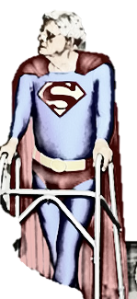

Methods: A Tale of Two Systems
V3NLP Framework
Stanford CoreNLP Toolkit
Notes:
Brief Version:
We built two systems, one built from a Rule based Platform (v3NLP Framework), and
One built from Sandford's Core NLP Toolkit – we used the Conditional Random Field (CRF) Tool
Longer Version:
Just a brief note about the technologies we are employing. Being the progenitor of V3NLP, now called Framework-legacy, (I think mentioned that in the paper), that’s the hammer I’m using to hit the preverbal nail.
These tool were built atop UIMA (Unstructured Information Management applications)
(that’s WHaT the Watson/Jeopardy technology was built upon).
Framework-legacy is similar in many aspects to its cousin in clinical NLP: cTAKES.
Framework evolved from MetaMap, a pioneering accomplishment in the bio-literature NLP realm,
customized and adapted to work with clinical records at the VA.
The tool has been used to find symptoms, military sexual trauma, colonoscopy quality as well as problems/treatments/tests in i2b2 records. We built off of two technologies. The other was an off the shelf NLP toolkit out of Stanford.
This toolkit is almost ubiquitous in the field.
Some of the systems built upon it
include disease name recognition,
de-identification and temporal events in the clinical genre.
I did not dwell much about this in the paper because there are a lot of papers describing and using the Standford CoreNLP toolkit. Both these tools USE well worn techniques to “de-compose” text into constituent parts: Sections, sentences, tokens and the like.

Slide 8

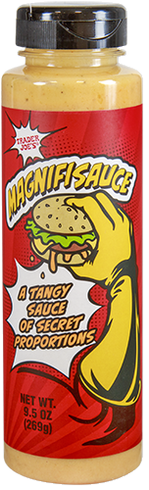
Methods: Rule-based: Categorized Lexica
Body Location Lexicon
53,704 SNOMED* terms
36 body laterality terms
(Body Strength Lexicon
4,802 SNOMED* terms
Range of Motion Lexicon
793 UMLS* terms
Body Function Qualifiers Lexicon
2,314 UMLS/UCUM* terms
Non-Body Function Lexicon (Confounding Terms)
70 Terms including pain, balance, coordination
Dictionary?!
Notes:
Segueing to the Rule-based Version:
The basis, the secret sauce for the rule-based pipeline are
dictionary-based term lookups to supply evidence.
Using my spidy powers, I pulled near complete coverage from traversing through UMLS hierarchies to pick up all relevant terms:
1* An amazing 54K body location terms,
But had to Hand curated an additional 36 laterality terms
2* 4K Body Strength terms
3* 800 Range of Motion terms
4* 2.3K qualifiers
5* 70 or so manually curated confounding terms.
A note here: if I found 4,000 ways of saying strength, how many records, how many manual annotations would I need to get that kind of coverage?
A particularly relevant ingredient: I used UCUM, a side terminology that covers units of measure – pound, degrees, joules, and the myriad abbreviations these have.

Slide 9
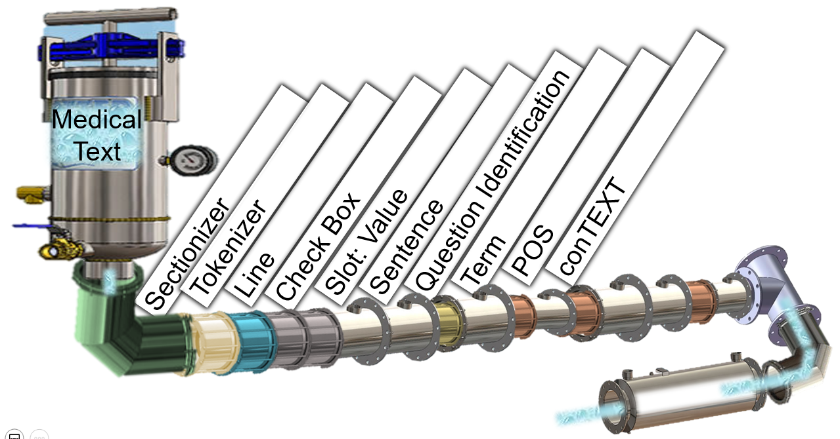

Methods: Rule-based: Basic Pipeline
Document Decomposition machine annotators to segment the text into
Sections
Sentences
Slot: Values
List Elements
Terms (via Dictionary Lookup)
ConTEXT Attributes (Negation, Conditional, Hx,)
Tokens
Handle Redactions
History of [First Name id=XXXX] Illness:
Infer newlines
There were no newlines in this data
Notes:
Before anything else is done,
a GENERIC pipeline
1* – segments/decomposes/parses the text into sections, sentences, slot:values, list elements, terms,
is employed.
As part of this GENERIC pipeline,
each term gets labeled with some useful attributes:
if is it negated, was it talking about something in the past, was it a hypothetical or conditional
2* A note about @$!% challenges in the NIH data – the demons within:
3* There were no newlines. NO NEWLINES. No newlines. I inferred some by looking for Section name patterns.
4* The data we got from BRIS was overly redacted.
Redactions within section names as an example.
I mention these here, because, far from being a one-off set of demons, they show up in datasets. Any experienced informatician would be lying he never saw these two demons before. I know for a fact that some of our SSA documents are also newlineless. This is reality.

Slide 10
Methods: Rule-based: Body Function Evidence and Qualifier Annotators
For Each Term in a Sentence
If Term’s Category == [BodyFunctionType]
If (Not Negated, historical, Subjective, conditional) Create a [Body Function Type] Annotation
Clinical Text
Evidences
SUBJECTIVE
A Sentence
Location
Body Function Type
Strength
in
Right lower extremity
5/5
For Each Term in a Sentence
If Term Category == [Number|Range|Fraction|Unit-of-Measure|Qualifier]
If (Not Negated, historical, subjective, conditional)
If ( no confounding term in sentence* )
Create a [Qualifier] Annotation
Assign a polarity – from lexicon or rule
Qualifier
Qualifiers
Notes:
Bear with me for a bit of pseudo code that describes the general pattern for looking for
1* The rule is simple – for each term in a sentence, look at the category, If the catgory includes Strength,ROM,Reflex
AND, the term has not been negated, or was historical, subjective or conditional
2* then make a body function type annotation.
3* I ‘ll obsess about one detail – if this piece of evidence
is attributed to the patient saying it – a symptom,
For this task - we are filtering that out,
on the grounds that this task is looking for objective, quantifiable mentions observed by a provider. Not all tasks have that criteria, but it does point to the need to distinguish who is saying what.
4* Quantification is a bit more complicated
for each term in a sentence, …
if the term looks like a quantifier, AND there are no counfounding things in that scope, (no pain, no balance, no coordination, no dates, then
5* create a qualifier

Slide 11
Methods: Rule-based: Body Function Mention Annotator
Body Function Mention
Clinical Text
:
A Sentence
Section
Strength
in
Right lower extremity
5/5
Body Function Type
Location
Qualifier
For each sentence
If the sentence is not in a “bad” section
if sentence contains:
At least one Body Function Type Annotation
At least one Body Function Location
At least one Qualifier
Create a BodyFunctionMention from the span of these annotations
Mentions
Notes:
Once all the evidences are in,
For each sentence,
if there is at least
one body function type,
a location,
and at least one qualifier,
make a body function mention
from the maximal span
from the first to last term
of those things.
Unless this would be in a forbidden section type – Such as a plan, or a Subjective section.

Slide 12
Methods: Stanford CRF
Tokens of Manual Annotations labeled with BIO Format
Labeled Tokens fed to CRF Model
Clinical Text
Strength
in
Right lower extremity
5/5
Begin-Strength
Inside-Strength
Begin-Location
Begin-Qualifier
Outside
Inside-Strength
Notes:
A quick mention about how we shoe-horned
our annotations into the other tool –
the one using the Stanford Core NLP tool.
We created Begin, inside, Outside (or BIO) annotations for each token of the annotations
– strength, rom, reflex, location, quantifier.
It is these annotations that got fed into the tool for training and testing.

Slide 13

Results
Table: Rule-based System (Token based Evaluation)
Table: CRF-based System
Label | F-1 Score | Recall | Precision
BF Mention | .6125 | .9452 | .4532
Qualifiers | .5699 | .8593 | .4263
Type | .6378 | .8888 | .4974
Body Location | .4696 | .8287 | .3276
Label | F-1 Score | Recall | Precision
BF Mention | .6578 | .8376 | .5415
Qualifiers | .6586 | .8442 | .5399
Type | .7287 | .8657 | .6291
Body Location | .5776 | .7548 | .4677
Notes:
Give you a minute to digest this table.
1* Overall, the rule based system did better at recall,
2* the CRF did better with precision,
3* and the overall f-metrics.
4* One reason for the rule-based system doing better at recall: The nearly complete coverage from the UMLS derived dictionaries.

Slide 14

Failure Analysis (Rule-based Method)
False Negatives
7 cases of weakness
Within the scope of confounding terms pain, balance, coordination
False Positives
93 cases of weakness
Statements the patient made or within subjective sections, or misidentified sections
Some number of false positive weakness mentions were true positives
32 cases of poor scoping
Patient reports right leg weakness
3 trials : Right : 60 , 60 , 62 Left: 60, 43, 50 Gauge was measured in
Notes:
We had opportunities to peek into the rulebased version
to examine where it was going off the rails.
Weakness kept coming up.
7 false negatives, 93 false positives (and a bunch of tp’s)
1* The false negative cases happened because they were filtered out due to a really close confounding term within scope – If we only had a better scoping mechanism to scope in and out things …
2* Of the 93 false positive cases of weakness, most of these
3* were where the statement was attributed to the patient (subjective),
and with cases where the statement came from subjective sections that were not correctly labeled as subjective.
4* And there were a bunch of poor scoping failures– it happened with a bunch of cases, not just weakness, where there were a bunch of test values, where it was not clear
what the numbers referred forward or back to.
These happened in poorly documented lists, nested slot values, tables,
5* I’ll also mention that some of the false positives (weakness cases) did turn out to be true positives
6*

Slide 15

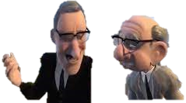
Discussion
Most of the failures were scoping around qualifiers
Annotation guidelines changed
Body Function Context
CRF Results were better than the rule-based system over-all but …
Our hardware limited the number of labels we can model.
Body Function mentions are not general English prose. Language models built from general English will not help find them.
Strength:
Left UE 3/5;
Not relevant
Not relevant
Right UE 1/5;
That’s the way to do it, that’s old school
Notes:
If the quantifier was missed, the mention was missed. Quantifier scoping was/is key to getting this all correct.
1* This situation kept coming up:
2-9* there were some intervening text between evidences,
but some
over-arching Section Name
providing the context
for these dis-contiguous pieces.
We do not have a useful way to annotate dis-contiguous tokens of an annotation. 10* Our next best thing was to identify the over-arching thing
as some kind of context that could be seen as a hidden evidence to make a full mention. 11* We changed the guidelines and, going forward, are annotating this way.
12* While the CRF results were better than the rule-based methods, we hit limits to how many labels we could train on.
13* We have tackled a task – divining mentions in an idosyncratic medical sublanguage, often with cryptic abbreviations only decipherable by wizards of the craft.
As such, techniques built from pre-trained language models, we surmise, will have trouble because of the lack of similarity in language usage, and the obtuse formatting that gets stripped out when using the current generation of segmentation tools.
14* We chose dictionary lookups
leveraging a-priori knowledge
inferred from UMLS sources
and a few rules
as one method
and
learning from the sequence based CRF model as the other.

Slide 16
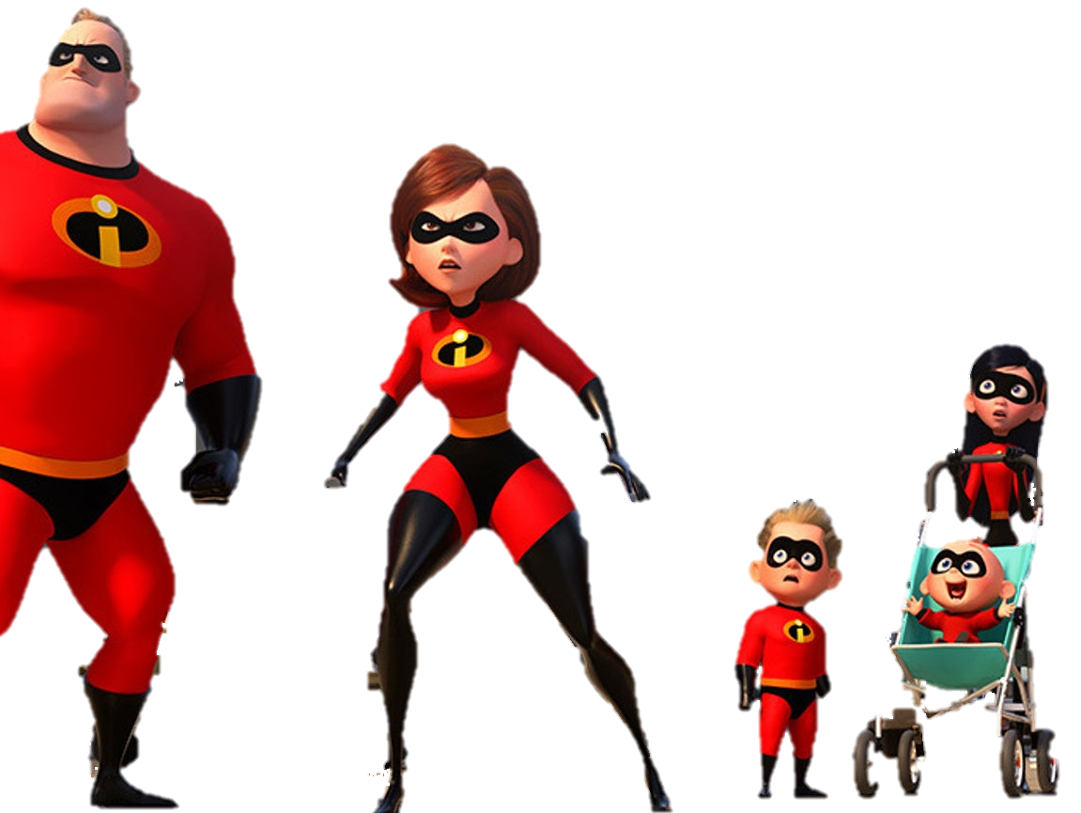
Ongoing/Future Work
Model the qualifiers (-1,0,+1)
Update the 500 Annotations with guideline changes
The software is being adapted to work with SSA claimant data currently being annotated
Work could be expanded to include balance, coordination, sight, hearing
Notes:
We are just getting to modeling the quantification polarity.
We are in the process of looping back to update the
NIH records with the updated schema (to cover context)
and fix the fp’s that were tps
The software is being adapted to work with the
SSA claimant data that’s being annotated.
The SSA data ismuch more heterogenous and challenging
in terms of formats and ocr noise wise,
(but not terminology wise, so far)
We …. could expand these techniques to include additional work related additional kinds of body function observations without too much effort
Once we divine how to improve the
scoping (document decomposition ) components,
we intend to release all of the code.

Slide 17
Polarity Attribute Evaluation
Each Qualifier has been marked with -1 or 0, or +1
Gold Qualifier Mentions
Copper Qualifier Mentions
Gold +1
Copper +1
Tp/tp+fn
Total Of those Qualifiers that overlap
Classified as -1 but was 0
Classified as -1 but was 1
Classified as -1 and was -1 (agreement coefficient)

Slide 18
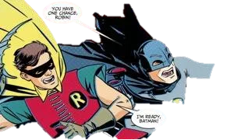
Polarity (unfiltered)
-1 83% correctly found
+1 77% correctly found
0 41% correctly found
Causes of Errors
Scoping errors where the qualifier was attributed to the wrong mention (122 cases)
Fed to the wrong classifier (unknown vs strength)

Slide 19
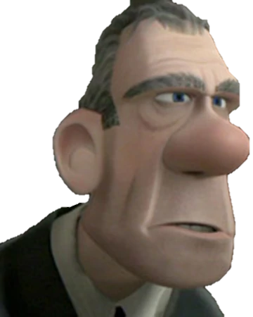
Conclusion and Acknowledgements
We built and benchmarked an NER to find Strength, ROM, and Reflex Body Function Mentions in Clinical Text
First NER to capture Body Function Mentions
(that we know of)
Supported by the Intramural Research Program of the National Institutes of Health and the US Social Security Administration
Contact Info: guy.divita@nih.gov
Notes:
1* We built and benchmarked an NER to find Strength, ROM, and Reflex
Body Function Mentions
in Clinical Text
We believe that we are the first to develop an NER to capture Body Function Mentions

Slide 20
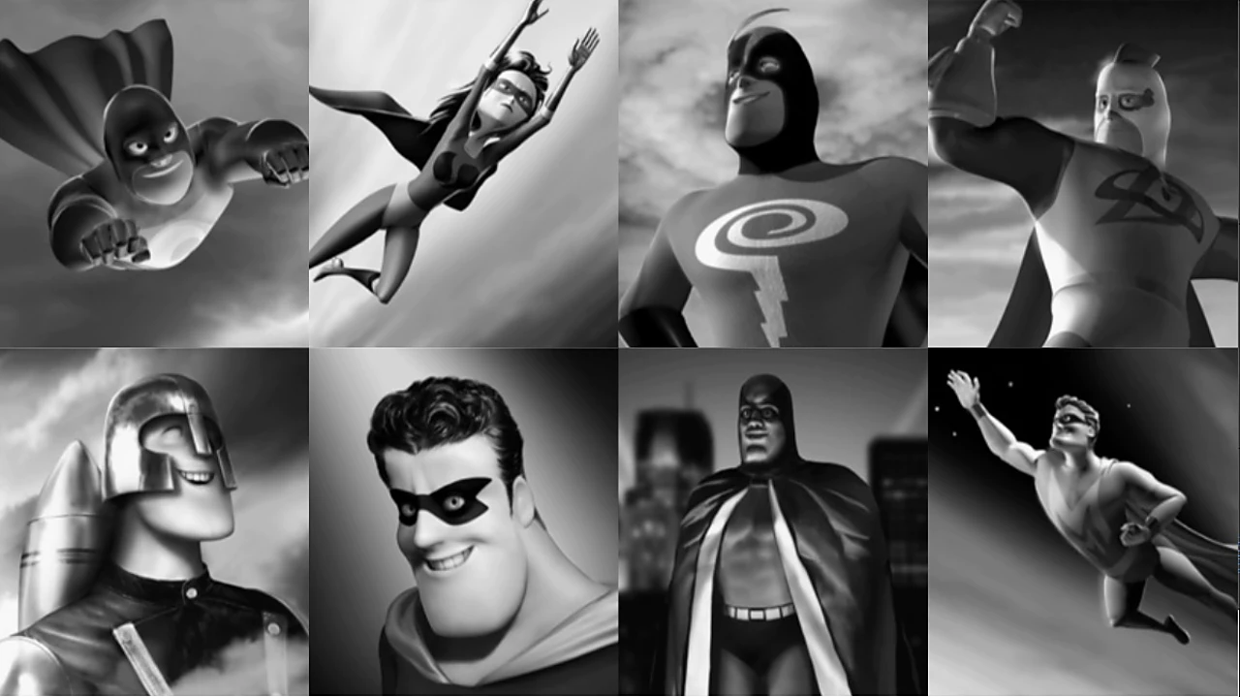
Prior Work
Kukafka, Bales, Burkhardt and Friedman: MedLEE used to identify ICF codes from Rehab Discharge summaries
Newman-Griffis and Fosler-Lussier link physical activity reports to ICF codes using language models and embeddings

Slide 21
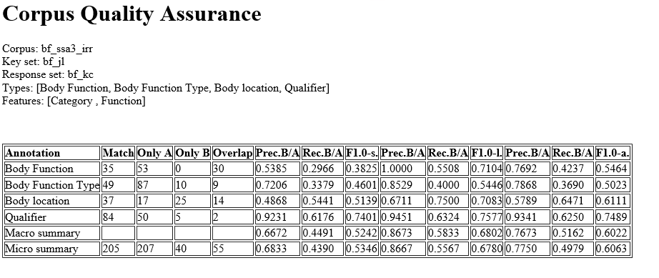
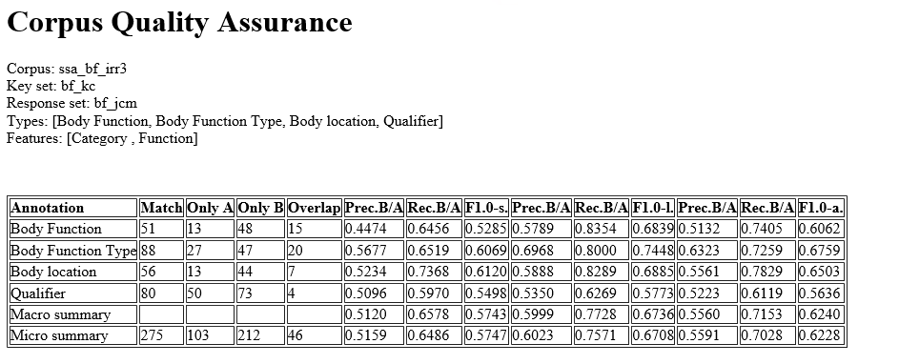
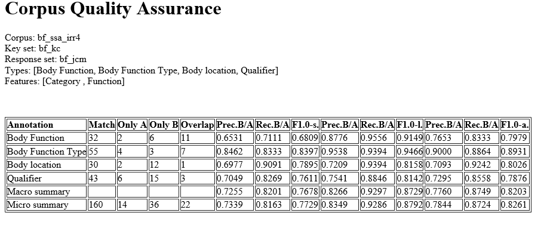

Slide 22
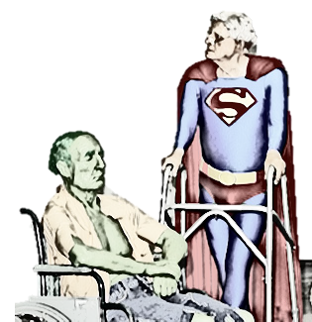
Methods: A Tale of Two Systems
V3NLP Framework
Evolved from MetaMap (MMTx), customized for clinical text at the VA
Similar to cTAKEs (UIMA based, UMLS dictionary Lookup)
Symptom Extraction, Military Sexual Trauma, Colonoscopy Quality, i2b2 problem/treatment/test
Stanford CoreNLP Toolkit
Disease Name extraction
De-identification
Clinical temporal events
Notes:
Brief Version:
We built two systems, one built from a Rule based Platform (v3NLP Framework), and
One built from Sandford's Core NLP Toolkit – we used the Conditional Random Field (CRF) Tool
Longer Version:
Just a brief note about the technologies we are employing. Being the progenitor of V3NLP, now called Framework-legacy, (I think mentioned that in the paper), that’s the hammer I’m using to hit the preverbal nail.
These tool were built atop UIMA (Unstructured Information Management applications)
(that’s WHaT the Watson/Jeopardy technology was built upon).
Framework-legacy is similar in many aspects to its cousin in clinical NLP: cTAKES.
Framework evolved from MetaMap, a pioneering accomplishment in the bio-literature NLP realm,
customized and adapted to work with clinical records at the VA.
The tool has been used to find symptoms, military sexual trauma, colonoscopy quality as well as problems/treatments/tests in i2b2 records. We built off of two technologies. The other was an off the shelf NLP toolkit out of Stanford.
This toolkit is almost ubiquitous in the field.
Some of the systems built upon it
include disease name recognition,
de-identification and temporal events in the clinical genre.
I did not dwell much about this in the paper because there are a lot of papers describing and using the Standford CoreNLP toolkit. Both these tools USE well worn techniques to “de-compose” text into constituent parts: Sections, sentences, tokens and the like.

Slide 23


Special Considerations
Qualifiers and Polarity
Terms like full equate to +1
Terms like positive equate to -1
Scale values of anything less than 5/5 or 10/10 equate to -1
Underspecified and Ambiguous Mentions
Raise arm overhead
Strength: assessed
Implicit Semantics
A fist can be made with both hands
Notes:
I may skip this – it’s in the weeds, me thinks

Slide 24

